Slide 1
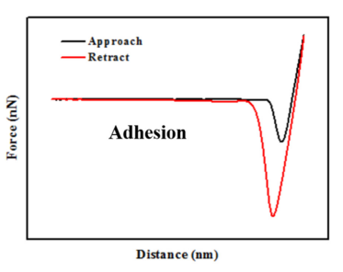
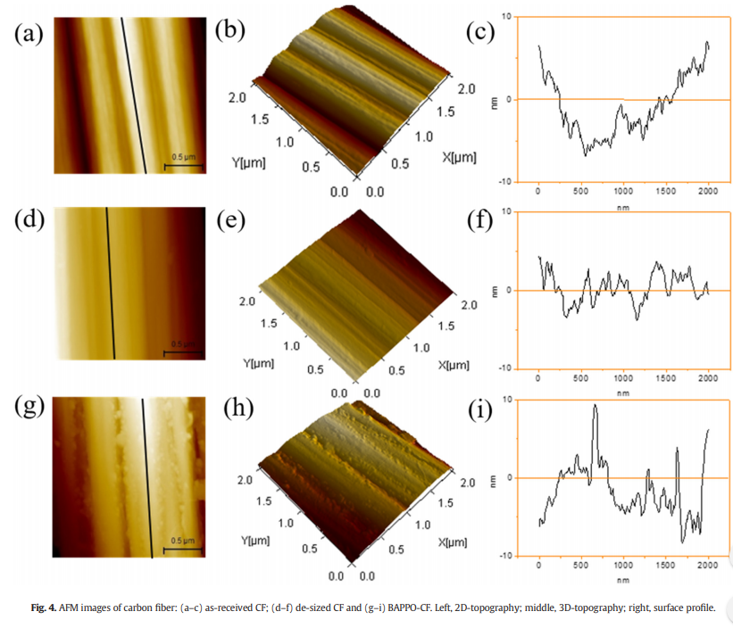

Adhesion force measured by atomic force microscopy for direct carbon fiber-epoxy interfacial characterization
Objective
The study contributes a new approach to investigate the interfacial adhesion in carbon fiber/epoxy composite by adhesion force measurement with the AFM
Sample Description
as-received CF sample: As known, the as-received T300 carbon fiber was covered by a layer of commercial epoxy sizing agent on its surface.
de-sized CF sample: The as-received CF was refluxed in acetone at 70 °C for 48 h to remove the surface sizing agent and other contaminants, and the obtained CF was denoted as ‘de-sized CF’
BAPPO-CF sample.
Process
Adhesion force measurement between CF substrate and epoxy functionalized AFM tip was performed in a commercial Nanoscope VIII MultiMode SPM system with Peak Force tapping mode at room temperature and a relative humidity of 40–60%
Results
This nanoscale manipulation by AFM provides a new avenue to measure the interfacial adhesion between the CF and epoxy at the molecular level.

